Slide 1
2020 Census Business Architecture View
George Mason University
Course: Spring 2017 Enterprise Architecture
Professor: Barry M. Barlow
Date: 2017/05/01
Presenter: Linus W. Freeman III
2020 Census Enterprise Architecture and Infrastructure Transition Plan (CEAITP): Business Architecture View

Slide 2
Four Key Innovation Areas
Reengineering Address Canvassing
Optimizing Self-Response
Utilizing Administrative Records and Third-Party Data
Reengineering Field Operations

Slide 3
Reengineering Address Canvassing Innovation
Touch Point => Reengineering Address Canvassing is designed to reduce the amount of in-field labor required to update the Master Address File (MAF) and associated technical products used for assessing where to count.

Slide 4
Reengineering Address Canvassing Innovation #2
In-office Address Canvassing (AdCan) will be completed nationwide using imagery and address files shared by local and tribal governments.
In-office AdCan is less expensive than in-field AdCan, but infield AdCan will still be required in up to 25% of all addresses.
The plans for reengineered address canvassing are expected to reduce field workload by up to 75% by adding new addresses to the Census Bureau's address frame using Geographic Information Systems (GIS) and aerial imagery instead of sending Census employees to walk and physically check all the census blocks.

Slide 5
Optimizing Self-Response Innovation
Optimizing Self-Response is designed to maximize the degree to which the respondent pool can successfully self-respond, reducing the cost of paper data capture and in-person Nonresponse Follow-up (NRFU).
By encouraging the population to respond to the 2020 Census using the Internet or the telephone, the need for more expensive options are reduced.

Slide 6
Utilizing Administrative Records and Third-Party data Innovation
Utilizing Administrative Records and Third-Party data is designed to reduce field workload by improving the efficiency of NRFU operations.
By using these alternative sources of data, NRFU operations can eliminate the need for multiple unproductive visits to housing units that are vacant, abandoned, or otherwise unoccupied.
It is expected that some nonresponding housing units will be enumerated in the 2020 census by using administrative records.

Slide 7
Utilizing Administrative Records and Third-Party data Innovation #2
The 2020 Census will enumerate many Group Quarters (GQs) through reference to administrative-type, third-party data.
By using data the public has already provided to the government and data available from commercial sources, the Census Bureau can realize savings to focus additional visits in areas that have been traditionally hard to enumerate.

Slide 8
Reengineering Field Operations Innovation
Reengineering Field Operations is designed to increase the efficiency of field operations, allowing managers and field workers to be more productive and effective.
Combining new operational control software and case management tools with GPS-enabled devices will improve the efficiency of field workers and allow faster and more accurate management of field worker labor and travel expenses.

Slide 9
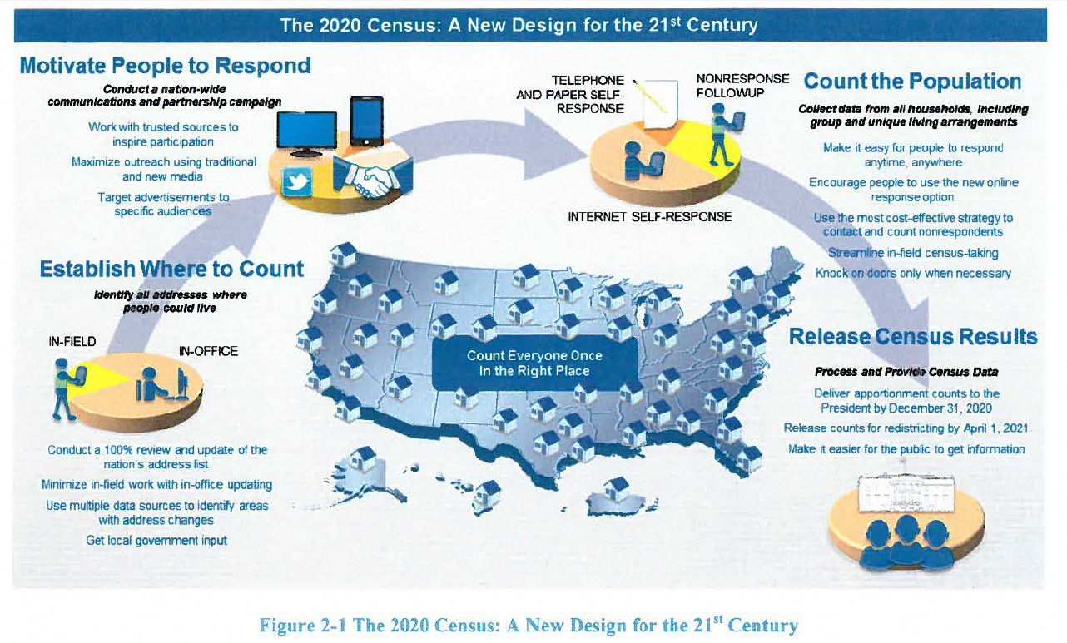
Notes:
Program overview
Figure 2-1 provides a high-level overview of how the 2020 Census will be conducted. This design reflects a flexible approach that takes advantage of new technologies and data sources while minimizing risk.

Slide 10
Successful execution of the 2020 Census
Successful execution of the 2020 Census will require coordinated efforts across a number of Census Bureau programs and will make use of resources from across the Census Bureau.
The capabilities required to compete the 2020 Census are expected to be developed in an evolutionary fashion, with periodic large scale tests designed to exercise these emerging capabilities in realistic settings.
Each builds successively from the prior tests, so that by the time of the first 2020 Census operations, the requisite capabilities are in place and have been field tested under realistic conditions.

Slide 11
Reengineering Field Operations
Reengineering Field Operations could potentially reduce the cost of the 2020 Census by over $5.2B as compared with repeating 2010 Census methods in 2020.

Slide 12
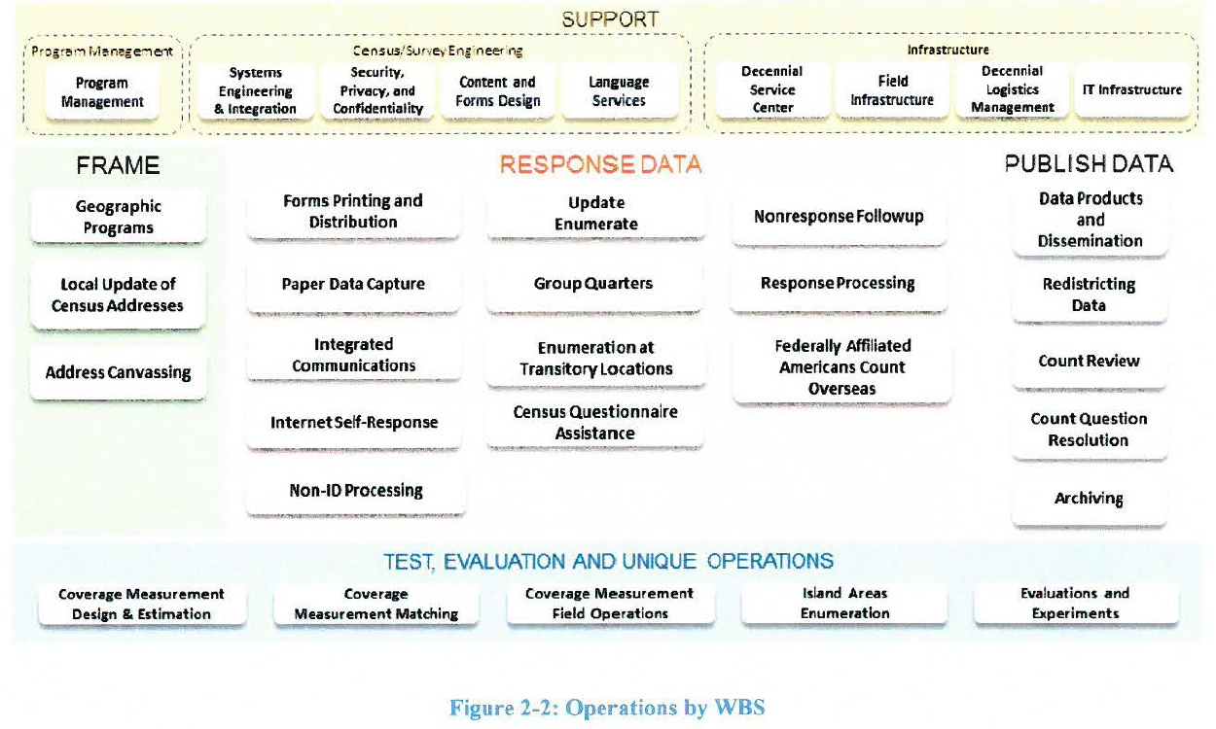

Slide 13
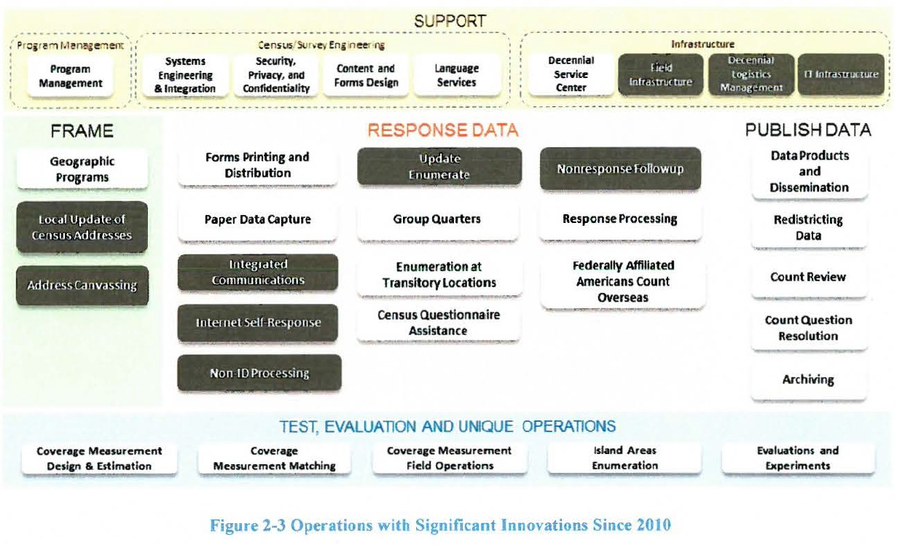

Slide 14
Address Canvassing Key Innovation (**Touchpoint**)
Use of a combination of In-Office and In-Field methods to achieve a 100 percent address canvassing (target of 25 percent of addresses going to In-Field)
Use of automation and data (imagery, administrative records, and third-party data) for In-Office Address Canvassing
Ongoing MAF Coverage Study to validate In-Office procedures, measure coverage, and improve In-Field data collection methodologies
Use of reengineered field management structure and approach to managing fieldwork, including new field office structure and new staff positions

Slide 15
Business Architecture Overview
The business architecture relies on the phased approach tests driven by a comprehensive list of the 2020 Census Architecture business requirements.
Each test re-uses the existing solution and technologies to the extent possible, introduces new enhancements of existing capabilities and/or replaces older legacy systems with new solution initiatives.
The general goals and objectives of each test are to support, evaluate, and modernize the existing solutions.

Slide 16
Business Architecture Overview #2
The business capabilities of the 2020 Census Solution Architecture align with the 34 Census business operations.
The Census Bureau and the Decennial Program will conduct various tests that drive the incremental transition of the solution architecture.
These tests and Censuses serve as effective tools in verifying the capabilities of each solution, while facilitating the design progression of the infrastructure to support the 2020 Census scalability requirements.
The specific capability requirements and Business Process Model (BPM) diagrams for each Test as well as their business requirements can be found in the requirements repositories, and are managed by the Decennial Architecture Requirements Team (DART).

Slide 17
Current Business Architecture
The information flows among the primary business operations for the 2015 NCT are highlighted in the Figure 4-1.
Major interactions and flows are shown via the arrows in the diagram and the key external interfaces are depicted via labeled icons.

Slide 18
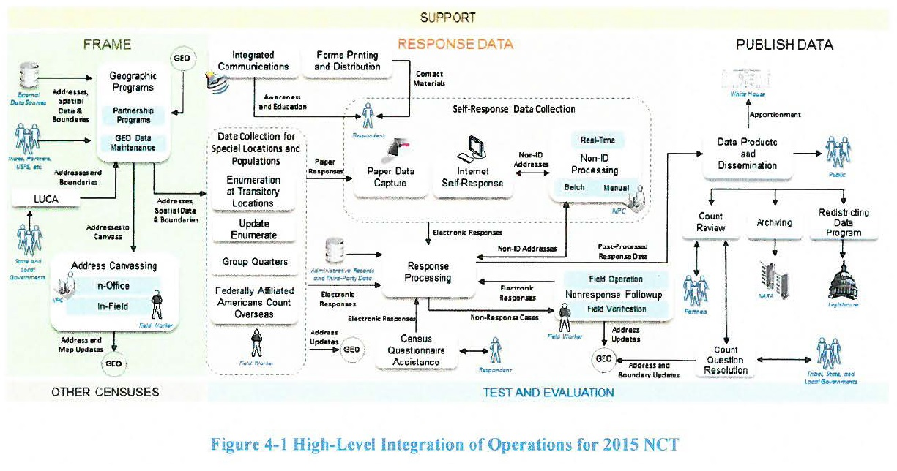

Slide 19
Current Business Architecture #2
The operation that was primarily being informed by the 2015 NCT was the Content Forms and Design (CFD) and the contact strategy which is currently developed in Internet Self-Response (ISR), but executed through Forms Printing and Distribution (FPD).
The other operations that participated in this test were implemented to support this test, but were not the focus of the test in terms of answering the design questions.
The 2015 NCT includes multiple operational areas that collectively provide the anticipated capabilities that map to the end-to-end survey lifecycle and are grouped into five categories: support, frame development, response data collection, disseminate data, and test, evaluation, and other censuses.

Slide 20
The Frame development segment (**Touchpoint**)
The Frame development segment entails activities within the geographic programs, LUCA, and Re-Engineered Address Canvassing. These activities support the task of developing administrative records frame, geographic delineations, and address canvassing.
LUCA was not part of the 2015 NCT, although it is part of the Geographic Programs.

Slide 21
Target Business Architecture
Figure 5-3 on the next slide shows how the operations are divided into the business architecture categories.
The 2020 Census Business Architecture describes the functional business process, the relationship, and the geography aspects of the business environment.
It is decomposed into multiple operational areas that collectively provide the anticipated capabilities that meet the end-to-end survey lifecycle phase and is grouped into five categories:
support, frame development, response data collection, disseminate data, and test, evaluation, and other censuses.

Slide 22
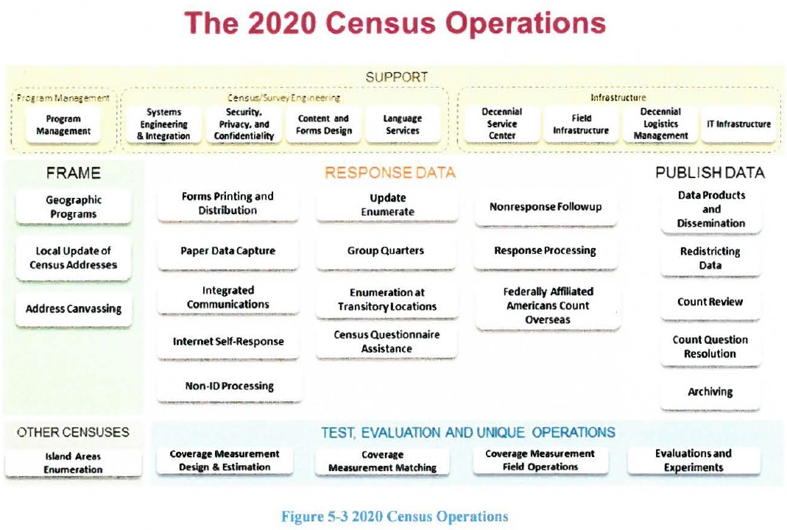

Slide 23
Two Touchpoints for Address Canvassing
In-Office Address Canvassing: 75 percent of all address canvassing will be “In-Office” using third party sources and administrative records along with Geographic systems.
In-Field Address Canvassing: Only 25 percent of remaining address canvassing will be “In-Field” resulting in large cost savings.
The next slide is the Level-0 Activity Model for the overall Address Canvasing workflow:

Slide 24
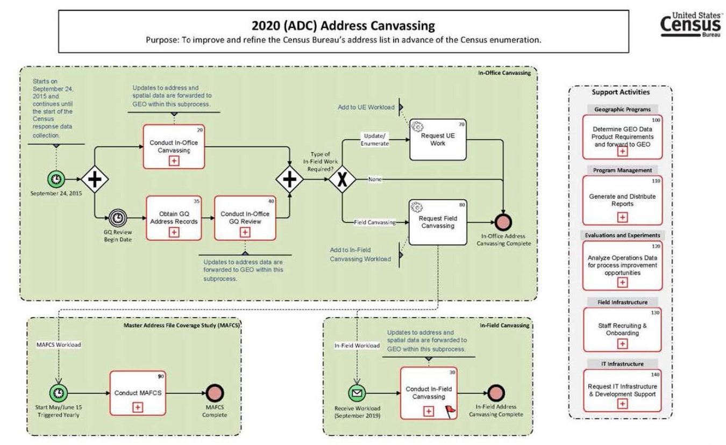

Slide 25
Two Touchpoints for Address Canvassing #2
Next is the Level-1 Sub-Activity Model for [In-Office] Address Canvasing workflow

Slide 26
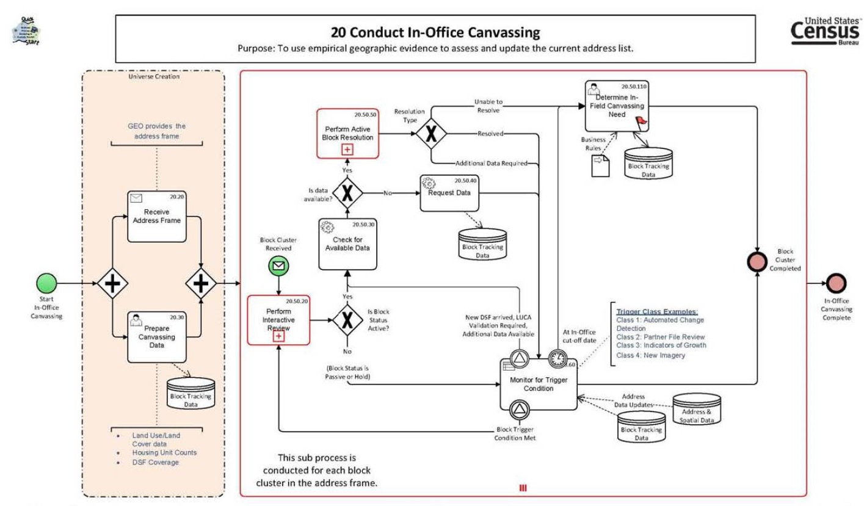

Slide 27
Two Touchpoints for Address Canvassing #3
Lastly, on the next slide is the Level-1 Sub-Activity Model for [In-Field] Address Canvasing workflow:

Slide 28
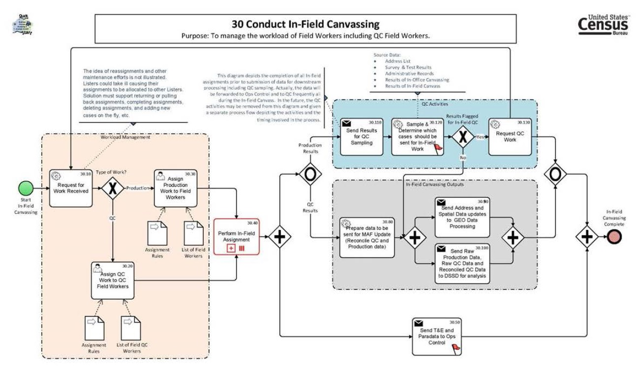

Slide 29
End of 2020 Census Business Architecture Presentation
Any Questions?

